Slide 1
Hackathon Title Find the Interest Amount for current year

Slide 2
COHORT CODE - QEA23QE018
GROUP - 06
Presented By :
Arulselvi M- 2271299
Glara Salini J - 2271318
Deepika S - 2271320
Santhosh Kumar A N - 2271417

Slide 3
Contents:
Problem Statement
Key Automation scope
Prerequisites
Project deliverables
Output
Screenshots
Learning outcomes

Slide 4
1. Find the EMI for Car with price of 15 Lac, Interest rate of 9.5% & Tenure 1 year. Display the interest amount & principal amount for one month 2. From Menu, pick Home Loan EMI Calculator, fill relevant details & extract all the data from year on year table & store in excel. 3. From Menu, pick Loan Calculator and under EMI calculator, do all UI check for text box & scales. Change the Loan tenure for year & month, check the change in scale. Re-use the same validation for Loan Amount Calculator & Loan Tenure Calculator
Problem Statement :

Slide 5
Key Automation Scope
Implemented all the feasible automation concepts in the project for better project outcome.
Validation of transactions and doing calculations
Extracting table values and storing in excel
Filling data in screen and multiple UI validations
Navigating from Menus
Reusable of methods
Scrolling down in web page

Slide 6
Website used https://emicalculator.net/
PREREQUISITES
Tools/Software used :
Selenium - Portable framework for testing Web applications and automating the process.
Java - High level Programming language.
Eclipse - Integrated Development Environment for various ‘Languages’.
Tools and Frameworks used:
TestNG – Open Source testing framework
POM – Object repository design pattern.
Apache POI – It is a POI library written in Java that gives users an API for manipulating Microsoft document.

Slide 7
Project deliverables
Tested the project manually and generated the functional testing reports.
Verified the project before starting the automation process.
Used the open source testing framework as an effective testing tool.
Utilizing Java which is a high level programming language increased the efficiency level of the project by its platform independency and easy compilation along debugging properties.
Implemented Maven in the project for managing the software and the project.
Updated the project along with the required screenshots as a reference for better understanding.
Created data-driven framework using Excel, XML and Json and handled the failed testcases.
Implemented the testing using multiple browsers(Google Chrome and Microsoft edge).
Achieved the necessary requirements and completed the project successfully which meets all its objectives.

Slide 8
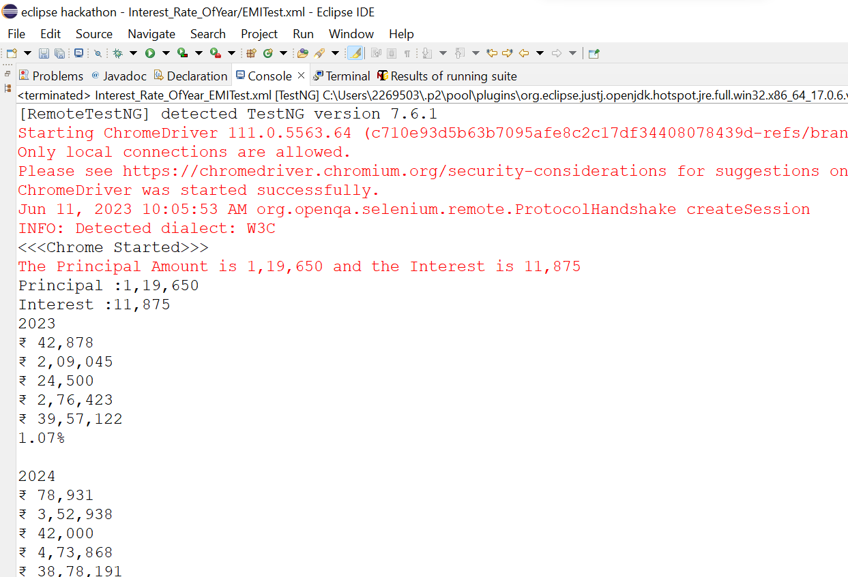
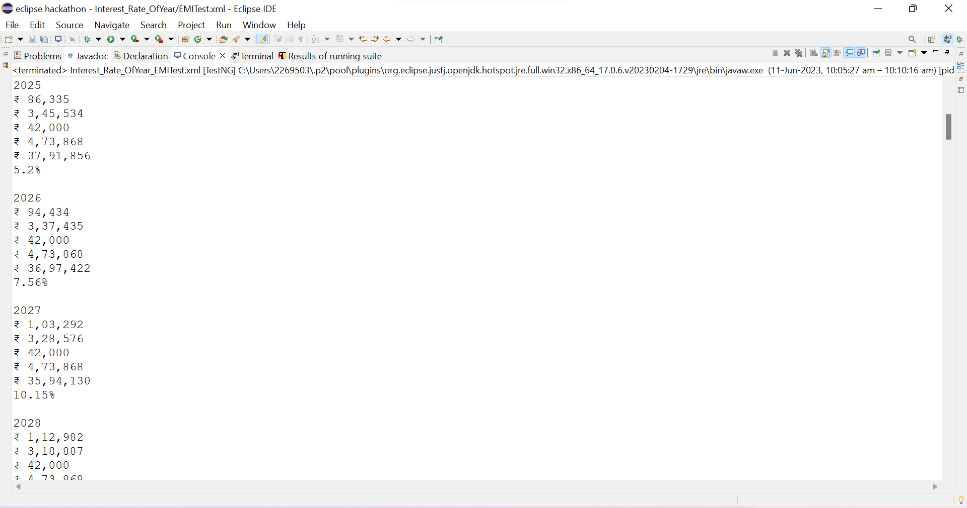
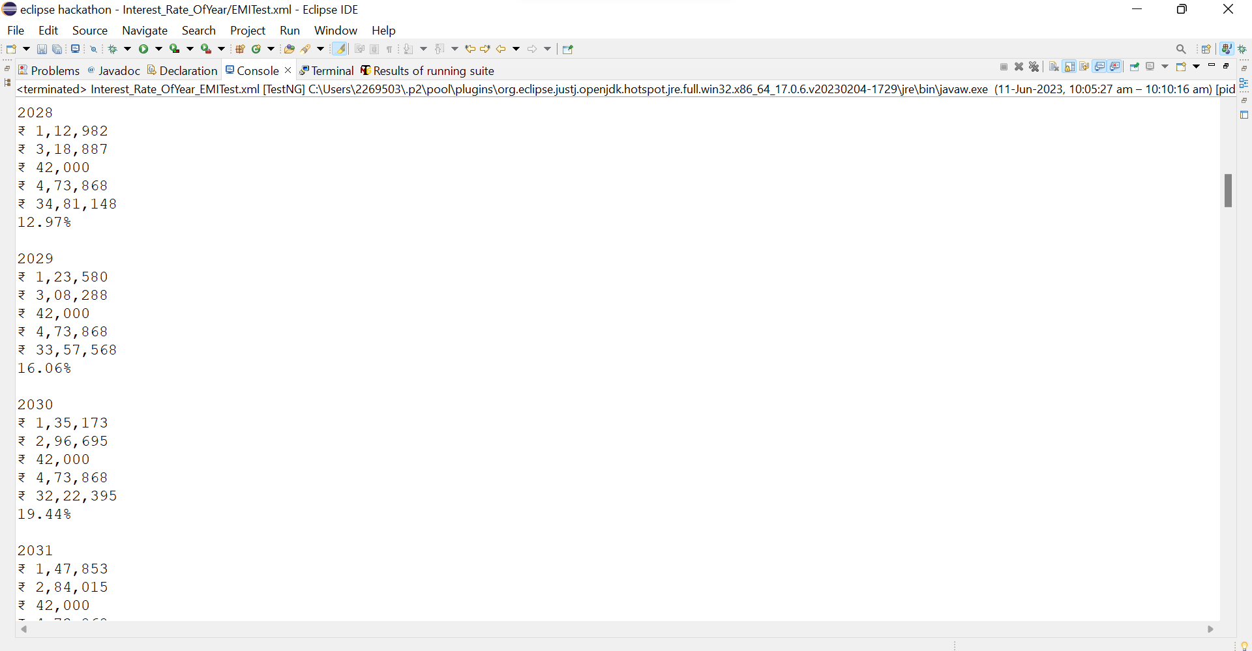
Output:

Slide 9
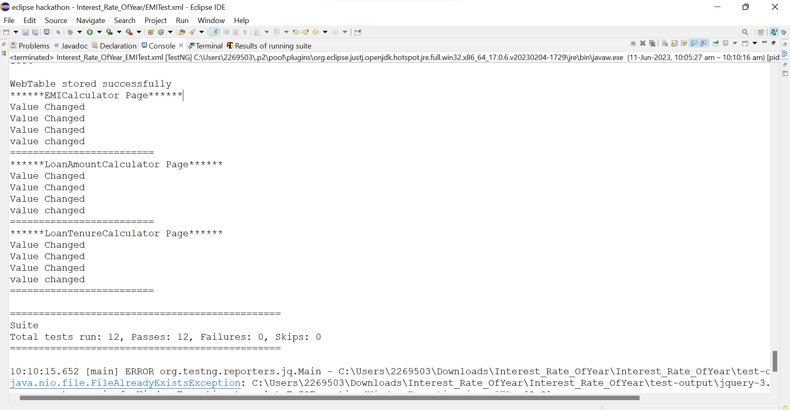

Slide 10
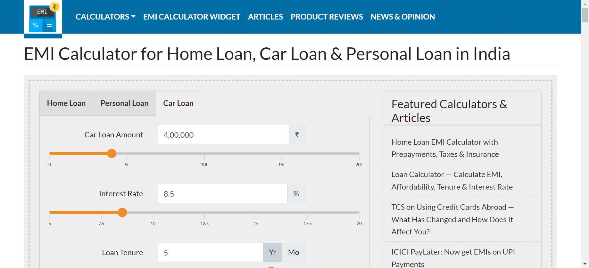
Screenshots
Figure 1- Car EMI Page

Slide 11
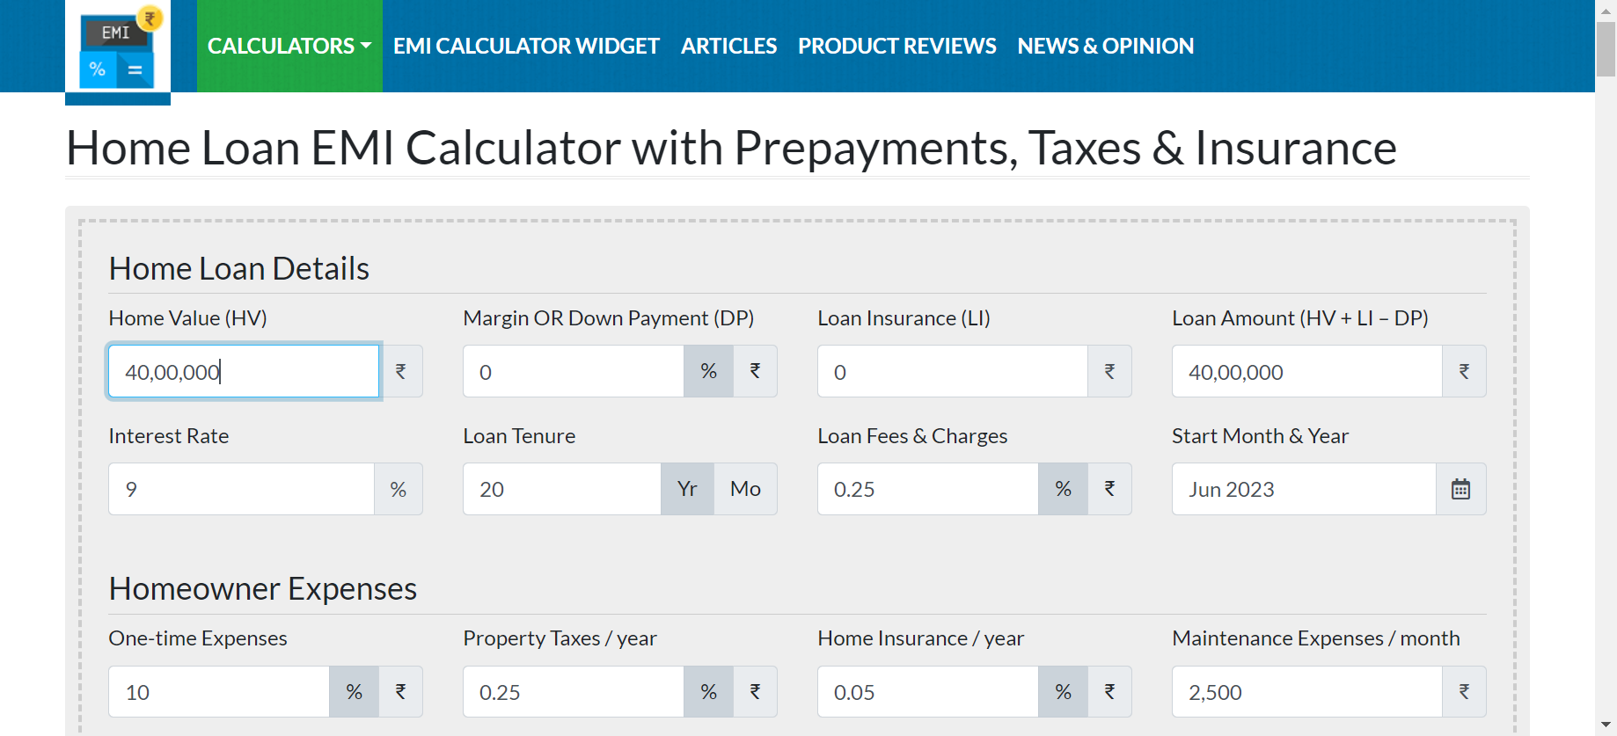
Figure 2- Home Loan Page

Slide 12
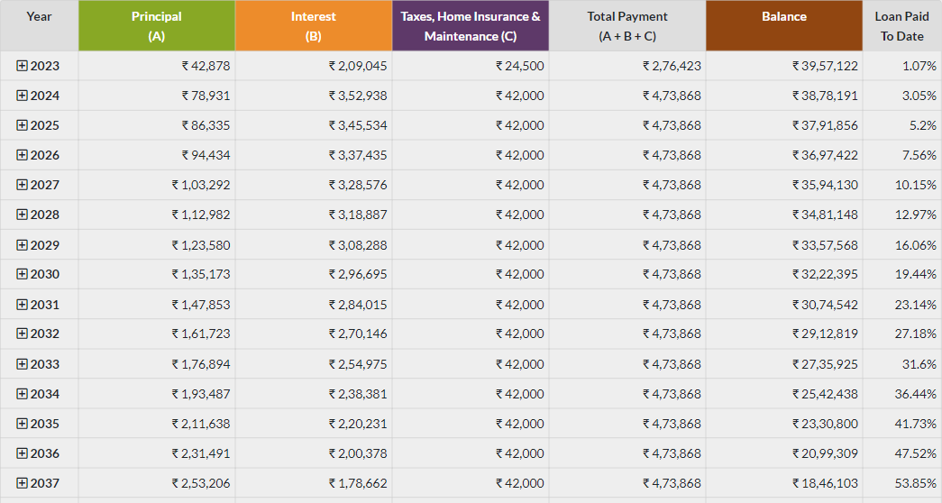
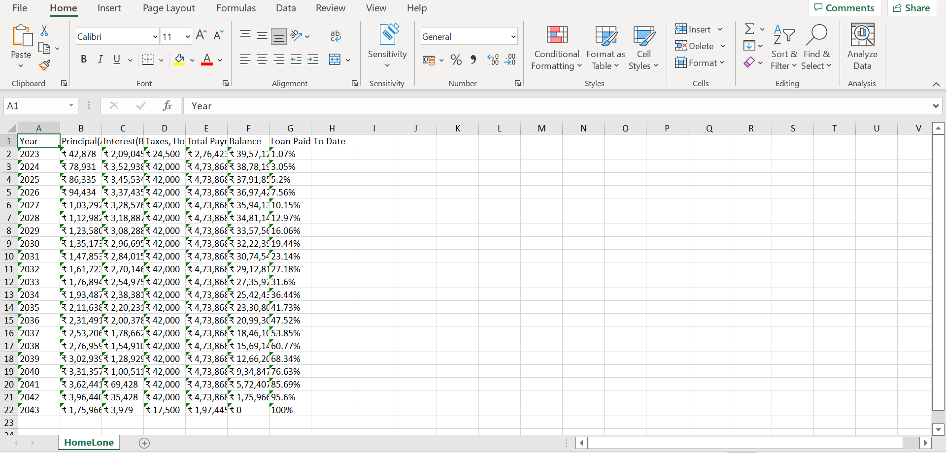
Figure 3- Table
Figure 4- ExcelSheet

Slide 13
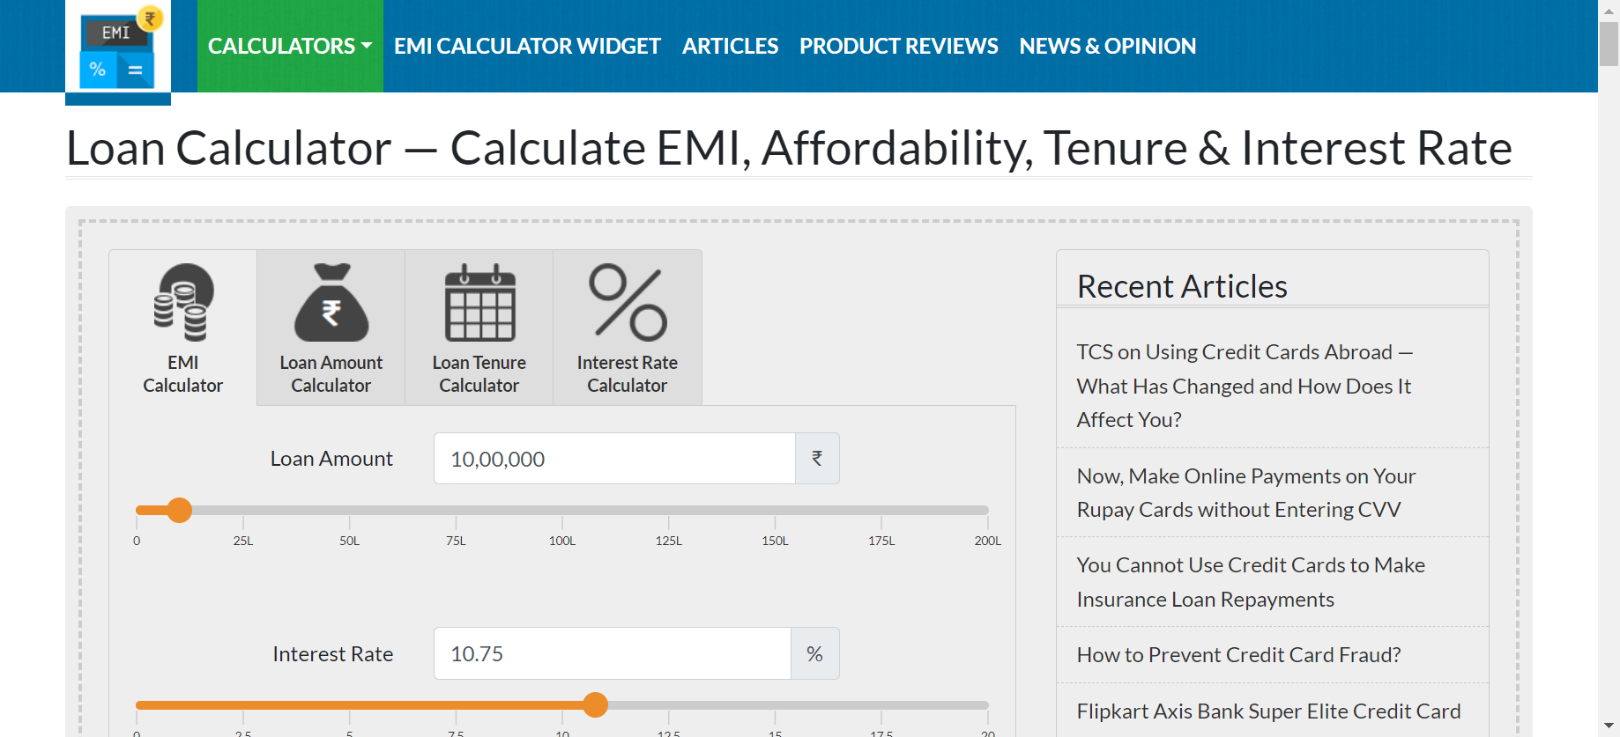
Figure 5- EMI Calculator Page

Slide 14
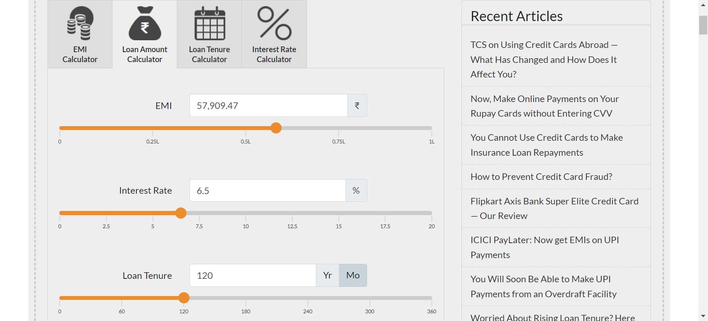
Figure 6- LoanAmountCalculatorPage

Slide 15
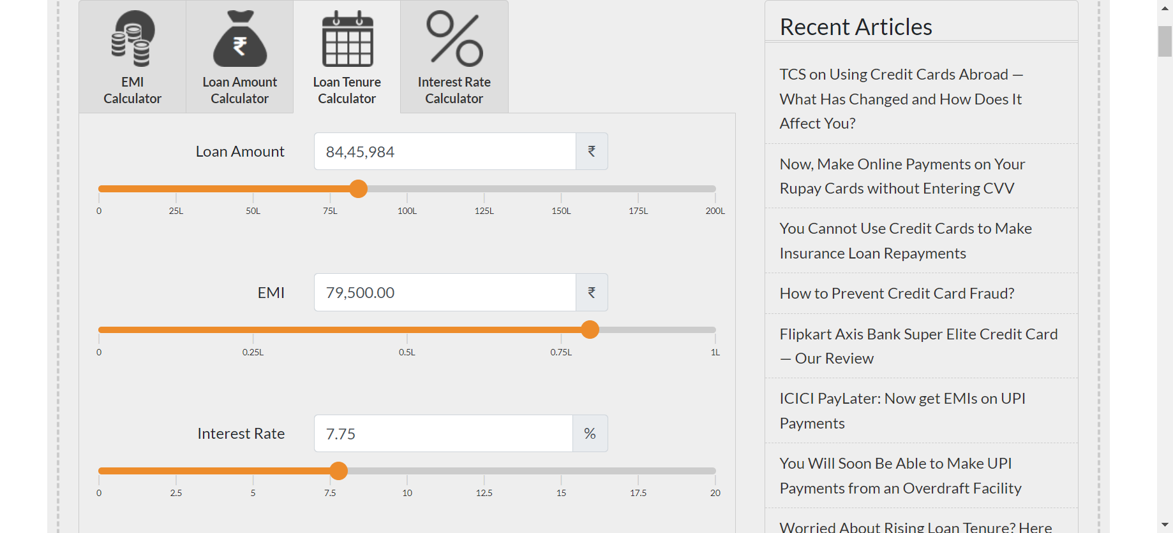
Figure 7- LoanTenureCalculatorPage

Slide 16
Learning outcomes
We were able to perform automation testing using selenium framework and gained knowledge on working with development tools.
Learned how to use the resources more efficiently through the project implementing procedure.
We working as a team realized the importance of team work and coordinated well to make the project well organized.
We got an understanding on how to automate tests across web browsers for web applications and to ensure their high quality.
We understood that testing the progressiveness and regularity increases the proficiency and functionality of the web applications.

Slide 17
Thank you

